Slide 1
Reducing Power and Ground Voltage Noise using Cadence PowerSI
EE-674
Fall 2024

Slide 2
Table of Contents
Project Objective and note
What is PowerSI
PowerSI Modes
Extraction Work Flow
Spatial Work Flow
Setup a 5 layer PCB model in PowerSI
1 power net
1 ground net
2 sources
1 small resistance termination at VRM for short circuit response
Simulating with Spatial Workflow
Identifying “hotspots”
Finding frequency of peak voltage at device locations
Finding Spatial distribution of voltage between power and ground plane
Placing decoupling capacitors to reduce resonant peak voltages
Simulating with Extraction Workflow
Finding power/ground plane impedance Z11 at device locations
Placing decoupling capacitors to reduce resonant peak power/ground plane impedance

Slide 3
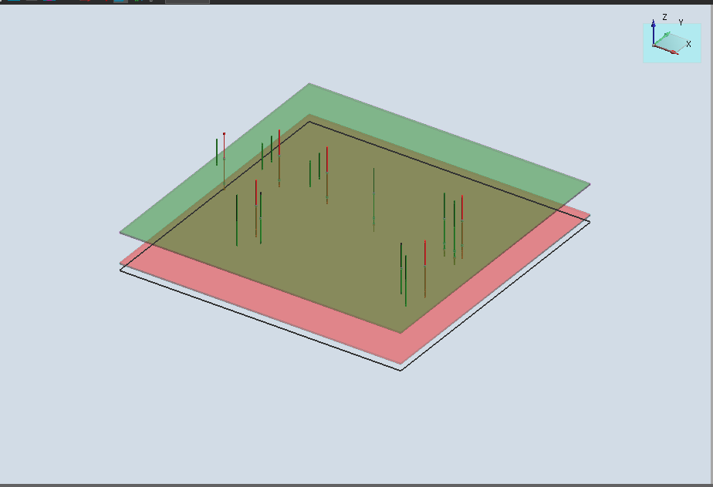
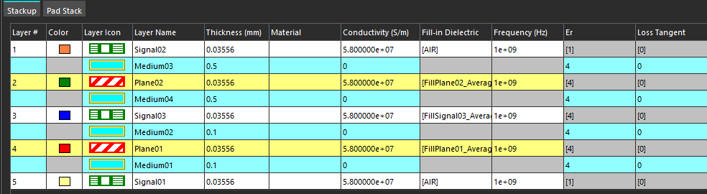
I. Project Objective*
In this project you will use PowerSI to determine value and locations of decoupling capacitors (maximum of 5) to reduce the power and ground voltage noise and impedance for a 5 layer printed circuit board.
*Note: In this tutorial:
the dielectric constant is ε_{r}=4,
the metal layers have thickness = 0.03556mm
the dielectric layer thicknesses are
Layer 1: 0.5 mm.
Layer 2: 0.5 mm
Layer 3: 0.1 mm
Layer 4: 0.1 mm
the plane x-y size is
x = 100 mm
y = 100 mm
* These values may be different in your design

Slide 4
II. What is Cadence PowerSI
PowerSI is a new generation power and signal integrity tool designed for the electrical analysis of integrated circuit packages and printed circuit boards.
It provides fast and accurate full-wave results and allows designers to overcome the challenge of high-speed design issues related to power, ground, and signal integrity.
PowerSI simulates electromagnetic field phenomenon by full-wave methods (e,g. direct solution of Maxwell’s equations without approximations) in the frequency domain.
PowerSI is used for the analysis and design of electronic packages including chip carriers and printed circuit boards.
Package designers often analyze the power-ground system of a package by looking at its frequency-dependent impedance; the lower the impedance, the better the power and ground system.
PowerSI Install instructions can be found at
https://docs.google.com/document/d/19mCAR2YfwvplPLo1_ipDft8VabcYndrY3BfVrZvxIhM/edit?usp=sharing

Slide 5
III. PowerSI Modes-Extraction
Extraction Mode
Extraction Mode allows the easy and convenient extraction of S, Z, and Y parameters of multiple port networks that model package and board structures, such as the power delivery system.
It can extract N-ports (of S, Z, and Y parameters) into the industry standard, Touchstone format, that can be used for subsequent analysis of larger scale systems.
Combined with Sigrity Broadband SPICE, Extraction Mode provides highly accurate SPICE models over broadband frequencies, which can be used for transient analysis of modeled structures along with any active or passive circuits with commercial SPICE engines.

Slide 6
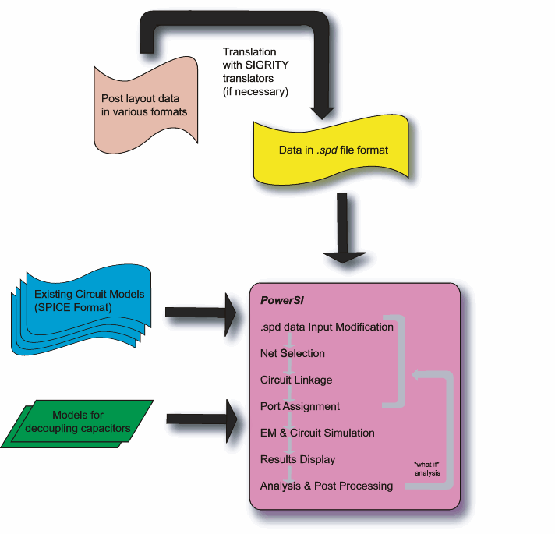
III. PowerSI Modes-Extraction Mode Flow
PowerSI Extraction Mode Flow
New layout
Layout designer

Slide 7
III. PowerSI Modes-Spatial
Spatial Mode
Spatial Mode handles circuits containing multiple sources, and performs AC analysis on these circuits. It can obtain spatial variations of voltages across planes as well as voltages and currents in the circuit and physical structure components. Spatial Mode can also:
Allow for multiple sources to be placed at various physical locations.
Provides for easy and convenient assessment of spatial voltage distributions across the entire structure.
Enable quick identification of “hot spots” and their corresponding frequencies where peak values occur.
Determine the desired characteristics of decoupling capacitors at the most appropriate locations.

Slide 8
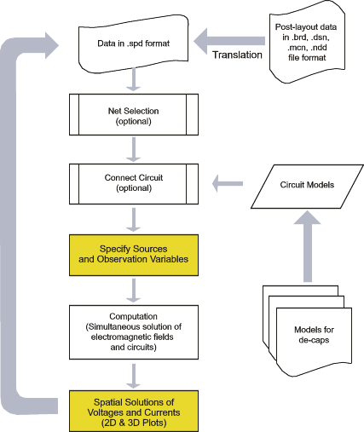
III. PowerSI Modes-Spatial Mode Flow

Slide 9
IV. Setup a 5 layer PCB model in PowerSI-Steps
Launch PowerSI
Start a New File; PCB model has by default number of layers is 4, size 100mm x 100mm
Edit the default stackup by adding a new signal layer between Plane01 and Plane02
Define a power (VDD) and a ground net (GND) and assign to Plane01 and Plane02
Check grid settings
Create new Pad Stack
Place VDD and GND vias for noise analysis

Slide 10
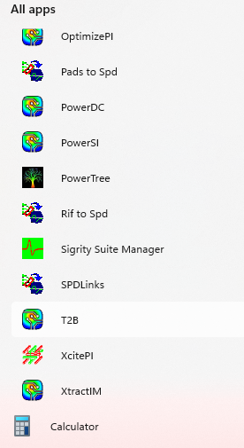

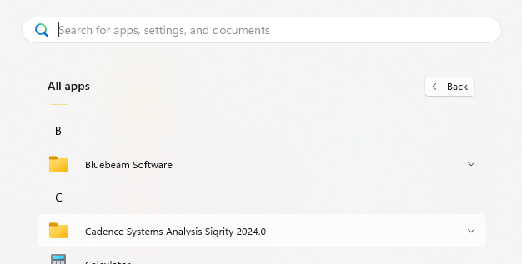
IV. Setup a 5 layer PCB model in PowerSI-Step 1
Go to all apps in Windows Start button
open Cadence Systems Analysis Sigrity 2024.0
Double click PowerSI icon
1
3
2

Slide 11
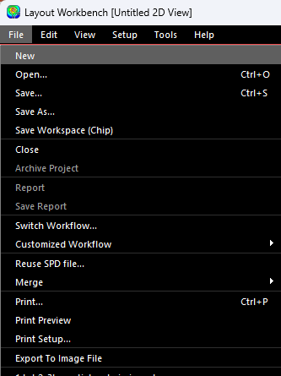
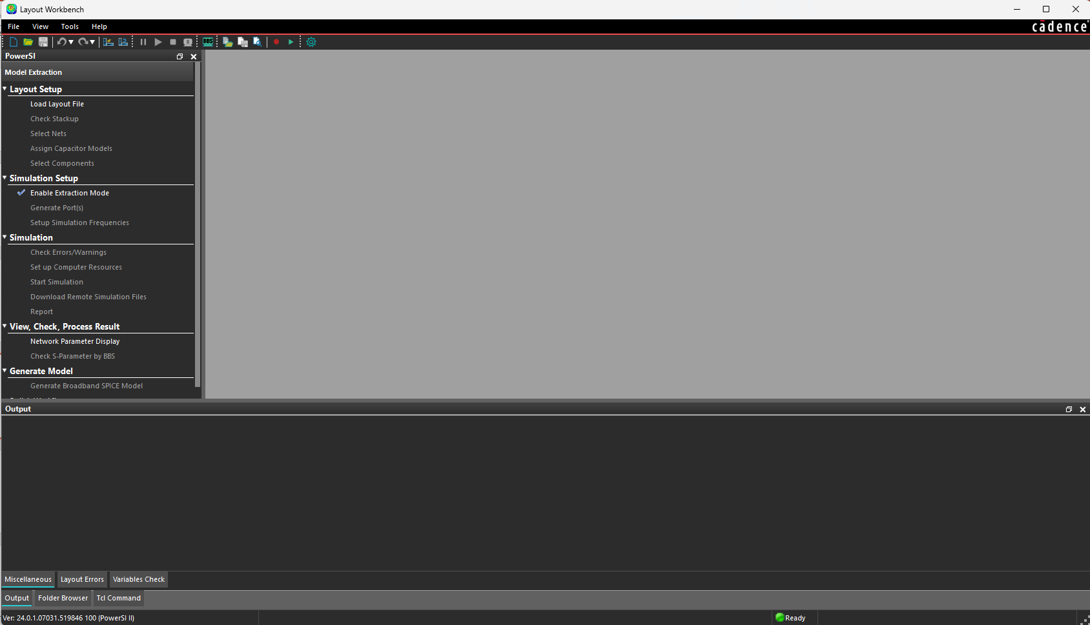
IV. Setup a 5 layer PCB model in PowerSI-Step 2
Click on File Menu
Click on New start a new project
1
2

Slide 12
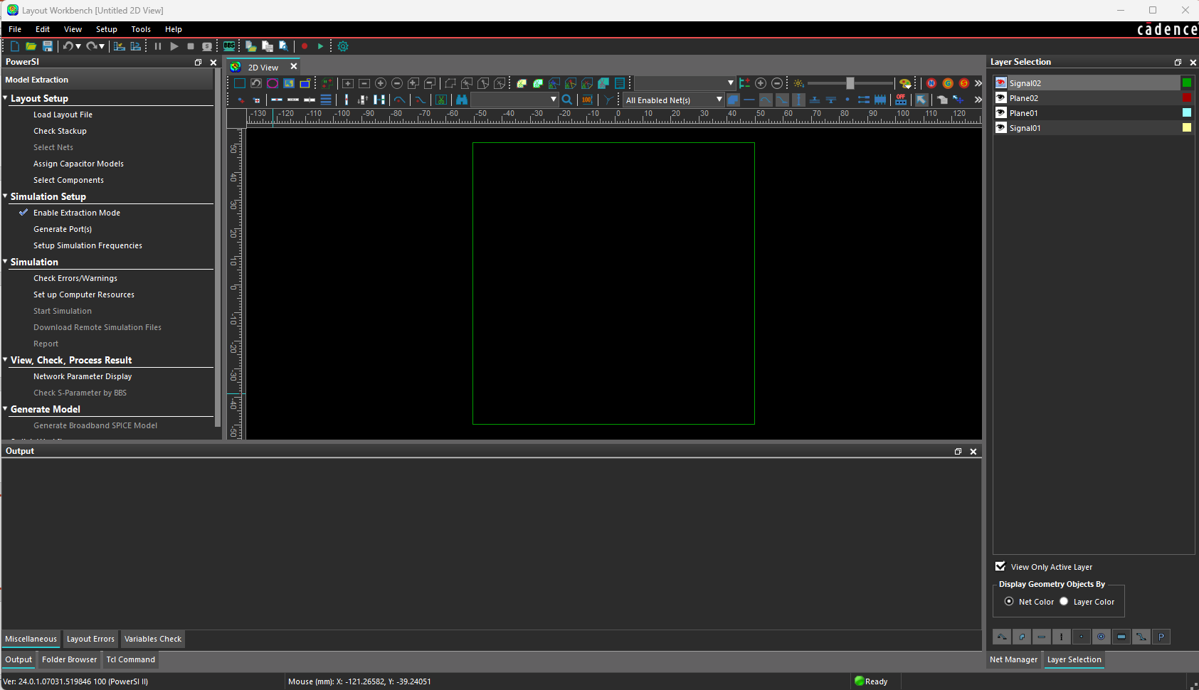
IV. Setup a 5 layer PCB model in PowerSI-Step 2
Major parts of the workplace when you open a new file in PowerSI.
A square 4 layer design is created
A
A - Menu bar
B - Toolbars
C - Workflow pane
D - Show area
E - Output/Folder Browser/TCL Reader pane
F - Layer Selection, Net Manager, or Component Manager
B
C
D
F
E

Slide 13
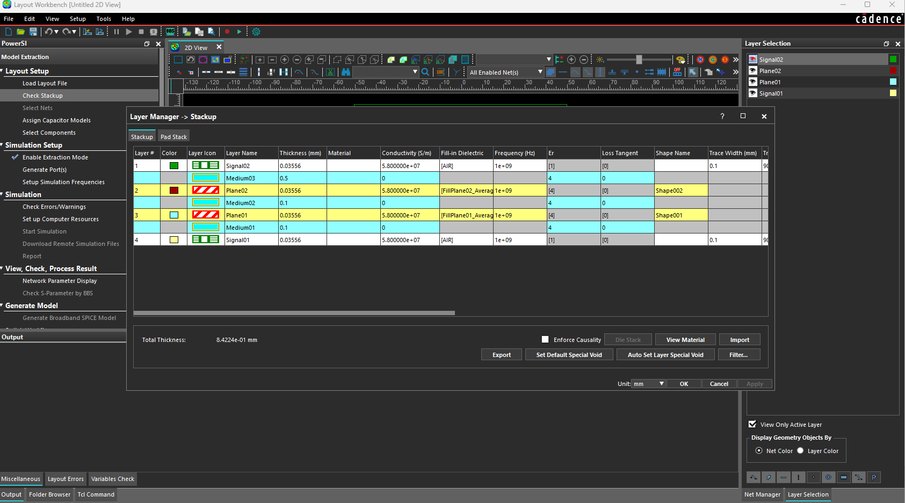
IV. Setup a 5 layer PCB model in PowerSI-Step 3
Select Check Stack up in the Workflow to open the Layer Manager
1

Slide 14
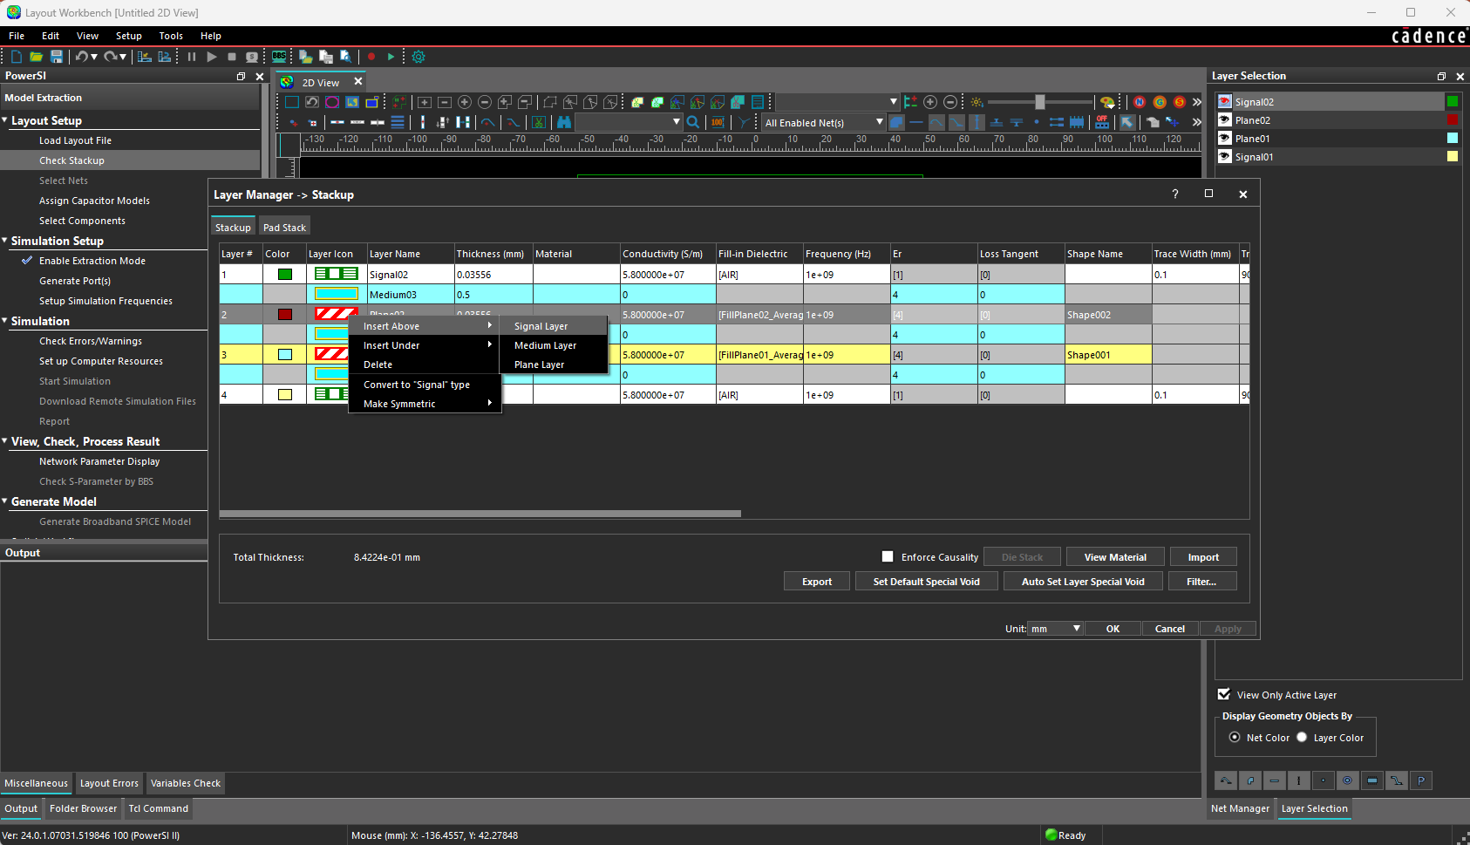
IV. Setup a 5 layer PCB model in PowerSI-Step 3
We will create a signal layer to create striplines (for another project)
Right click on layer 2 and
Insert Under then
Select Signal Layer option
3
1
2

Slide 15
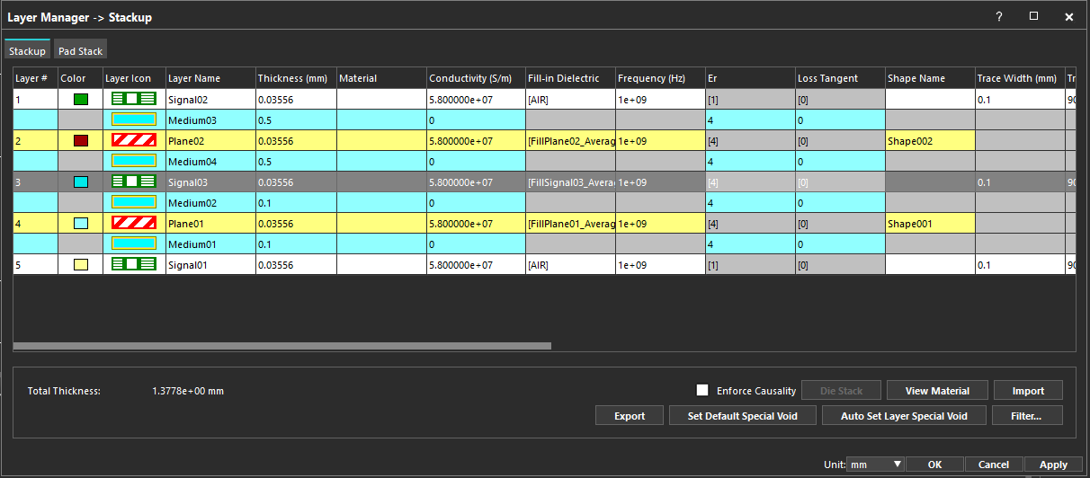
IV. Setup a 5 layer PCB model in PowerSI-Step 3
This is our new 5 layer stackup
1. Click ok
1

Slide 16
IV. Setup a 5 layer PCB model in PowerSI-Step 3
This is our new 5 layer stackup
Note surrounding dielectric layers
Editable fields

Slide 17
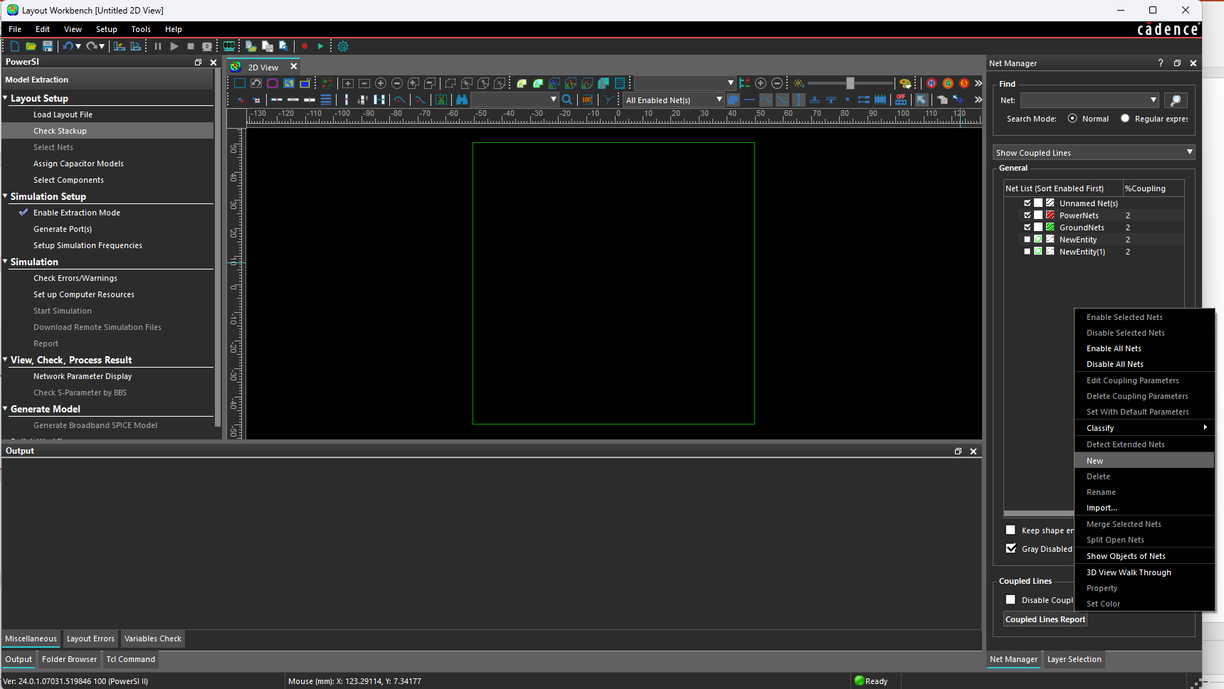
IV. Setup a 5 layer PCB model in PowerSI-Step 4
Create two nets, VDD and GND
Right click in the Net Manager window
Click New
Repeat steps 1 and 2
Double click the NewEntity net names to rename one to GND and the other VDD
Click on box icon next to net name andSelect green for GND color
Select Yellow for VDD
5
Right click here in this area.
To get menu to create New nets
4
1
3
2

Slide 18
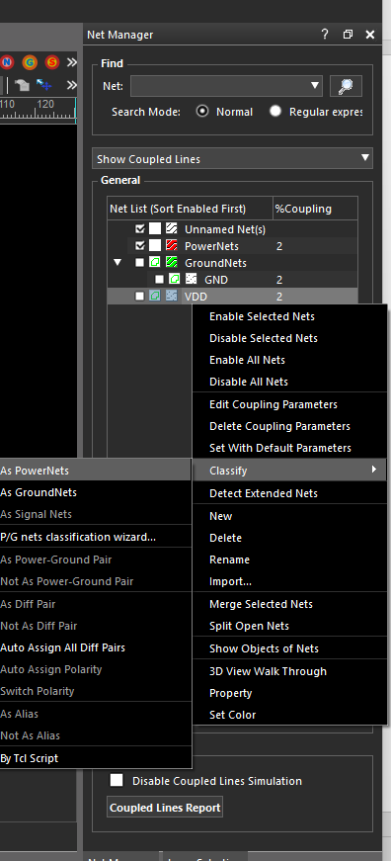
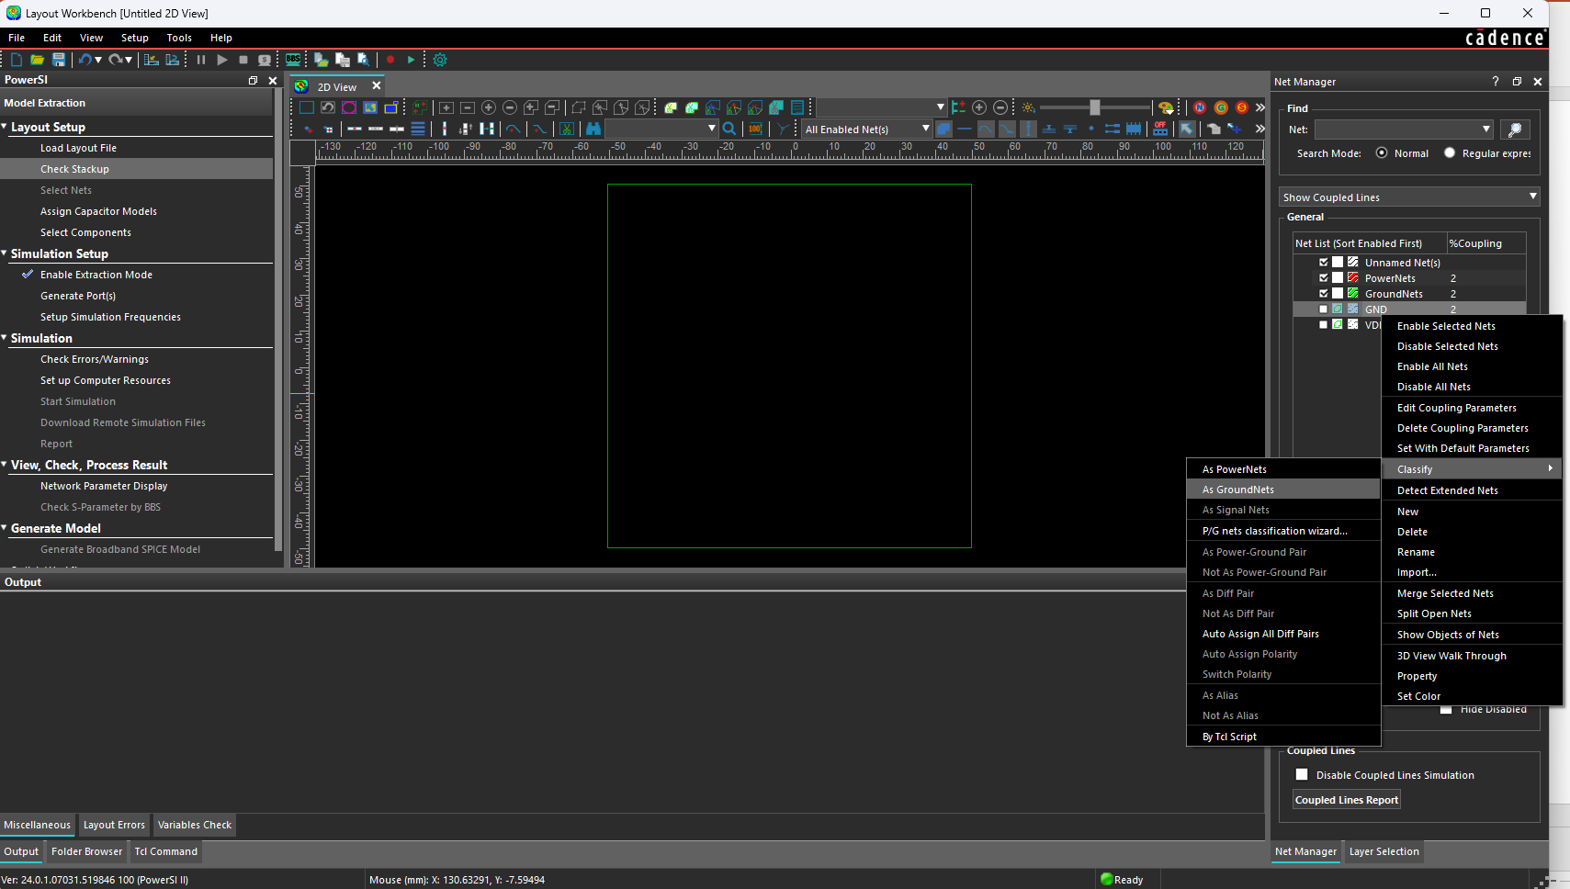
IV. Setup a 5 layer PCB model in PowerSI-Step 4
Classify GND net as a GroundNet and Classify VDD as a PowerNet
Right click on GND net
Select Classify
Select As GroundNets
Right click on VDD net
Select Classify
Select As PowerNets
4
1
6
5
3
2

Slide 19
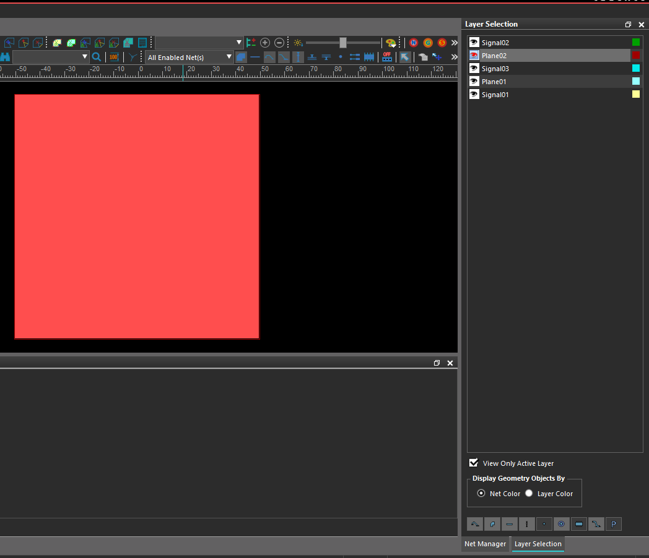
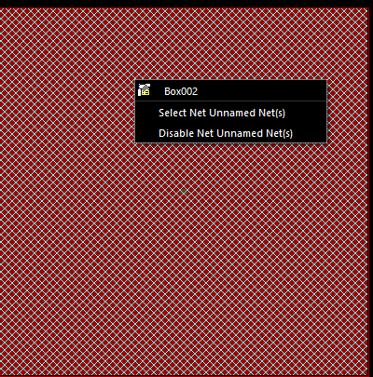
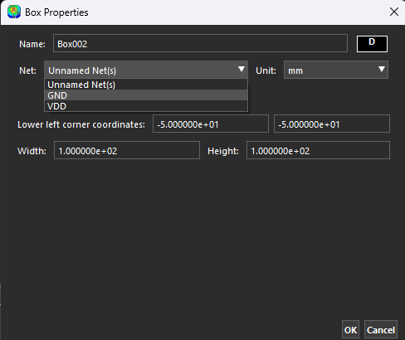
IV. Setup a 5 layer PCB model in PowerSI-Step 4
Assign Plane02 to GND net
Select Plane02 as your active layer
Right Click on shape to get shape menu
Click on shape name Box002 to get properties
Assign shape to net GND from the pulldown menu

Slide 20
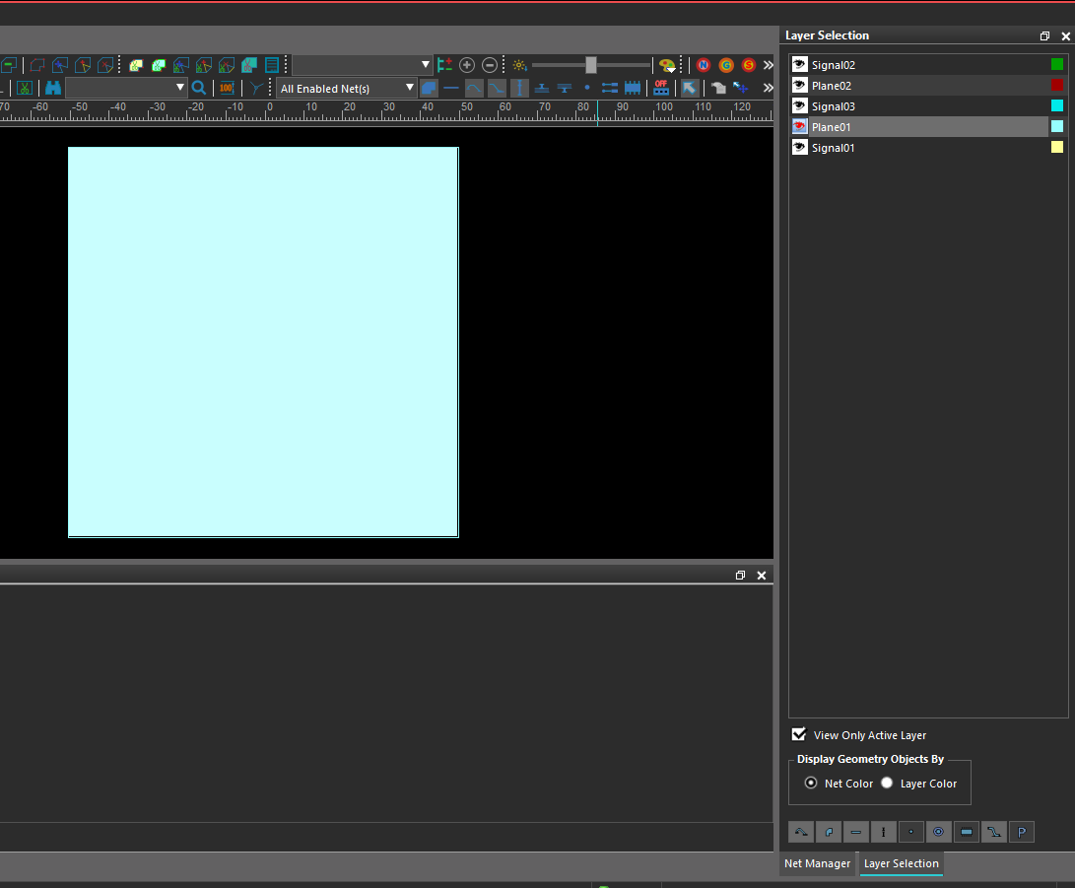
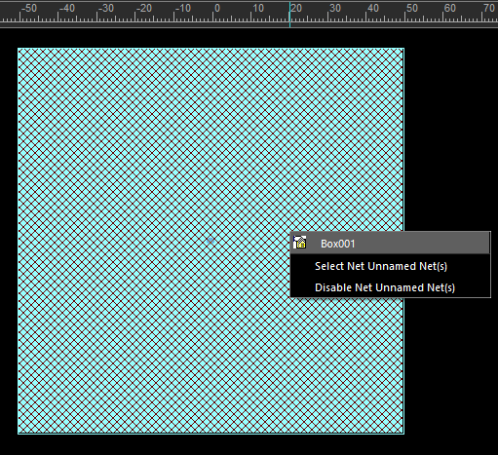
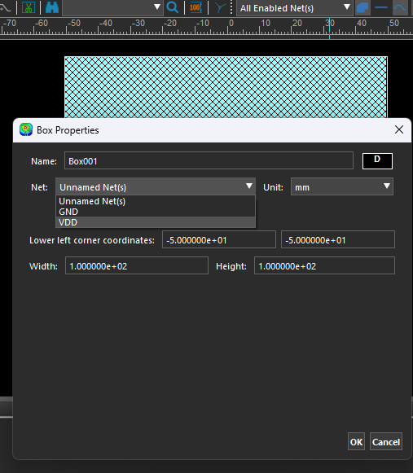
IV. Setup a 5 layer PCB model in PowerSI-Step 4
Assign Plane01 to VDD net
Select Plane01 as your active layer
Right Click on shape to get shape menu
Click on shape name Box001 to get properties
Assign shape to net VDD from the pulldown menu
1
2
3
4

Slide 21
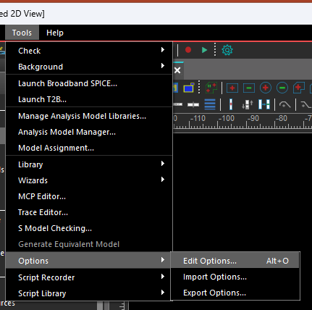
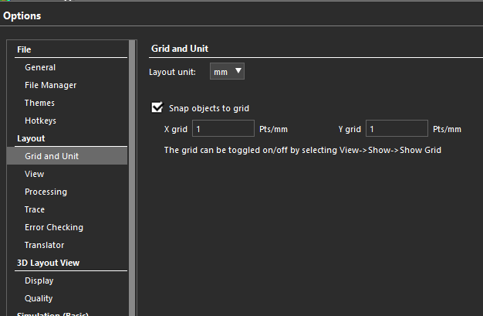
IV. Setup a 5 layer PCB model in PowerSI-Step 5
Check grid settings
Go to Tools menu
Select Options>Edit options
In Options menu select Grid and Unit under Layout and set layout unit to mm and snap objects to grid
1
3
2

Slide 22
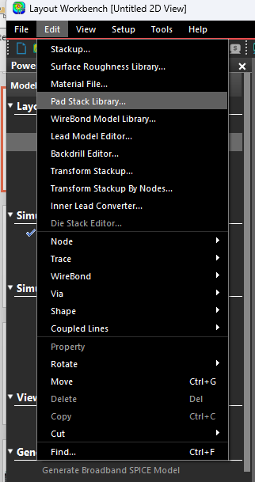
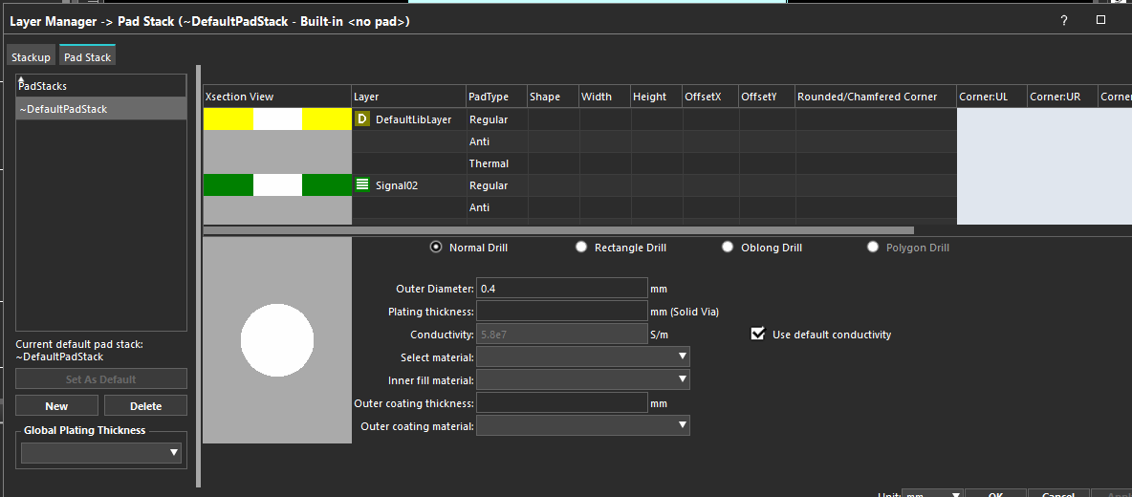
IV. Setup a 5 layer PCB model in PowerSI-Step 6
Create a new padstack for model vias
Click on Edit menu and
select Pad Stack Library …
Click on New button to create new Pad Stack
Double click on NewPadStack and Rename to trainingPad
Select the
1
2
3

Slide 23
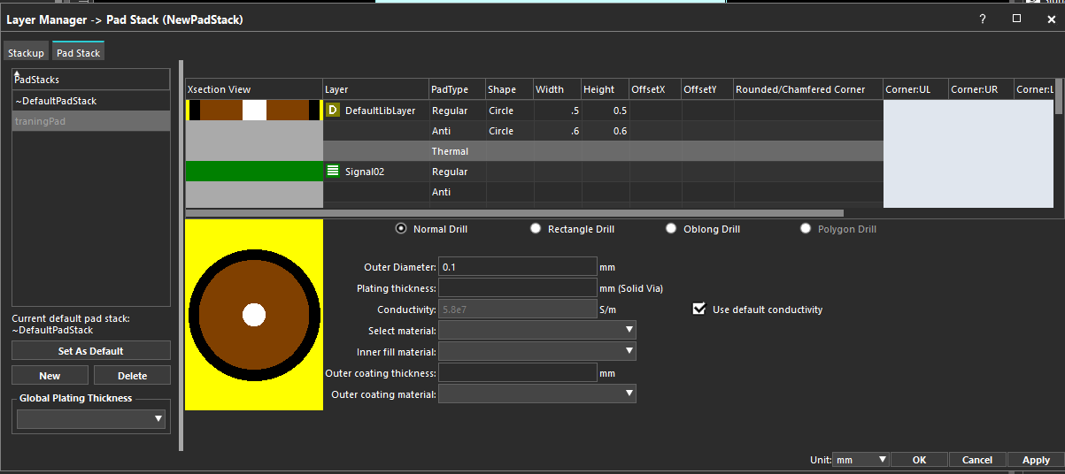
IV. Setup a 5 layer PCB model in PowerSI-Step 6
Enter pad dimensions for DefaultLibLayer for new pad stack trainingPad
Select the new pad stack trainingPad
Select circle for Pad Shape with width 0.5 mm for the DefaultLibLayer
Select circle for Anti Pad with width 0.6 mm for the DefaultLibLayer
Enter 0.4 for Outer Diameter
Click Set As Default button to set this via padstack as default for all vias
1
3
2
4
5

Slide 24
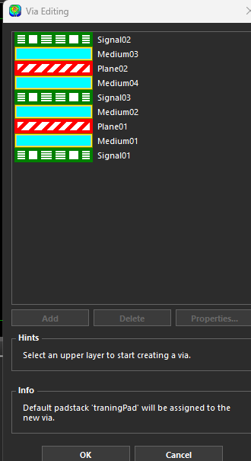
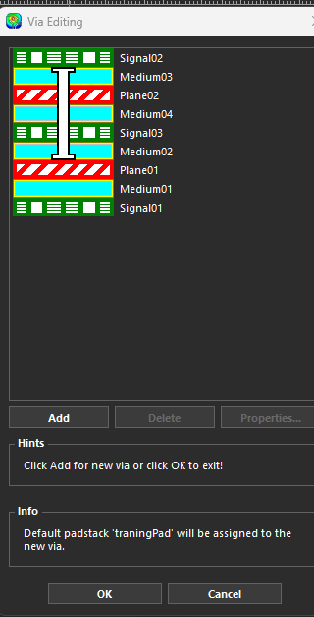
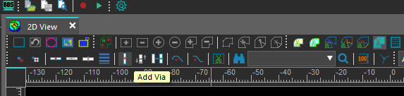
IV. Setup a 5 layer PCB model in PowerSI-Step 7
Create vias for VDD and GND connections from Signal02 Layer
Left click on add via icon then left click on PCB area.
In the Via Editing window select upper layer to start creating via
Select lower layer to complete creating via.
The via will be created using the Default padstack
Click Add
Add vias using table below
Note:
VDD vias will be from Signal02 to Plane01
GND vias will be from Signal02 to Plane02
2
Click upper layer first
1
3
Click lower next
Via | X coordinate | Y coordinate | Layer connection
VDD | -35 | 12 | Signal02 to Plane01(VDD)
VDD | -47.5 | 1.5 | Signal02 to Plane01(VDD)
VDD | -25 | -15 | Signal02 to Plane01(VDD)
GND | -35 | 8 | Signal02 to Plane21(GND)
GND | -47.5 | -2.5 | Signal02 to Plane21(GND)
GND | -25 | -25 | Signal02 to Plane21(GND)
6
5
4

Slide 25
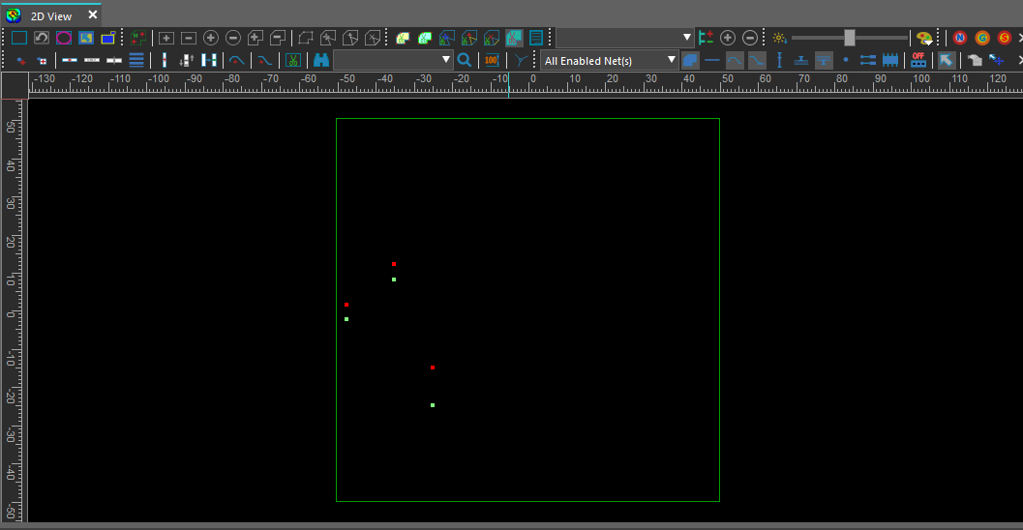
IV. Setup a 5 layer PCB model in PowerSI-Step 7
PCB should look like image below after via placement
Note the via labeling for devices and VRM
Device 1
VRM
Device 2

Slide 26
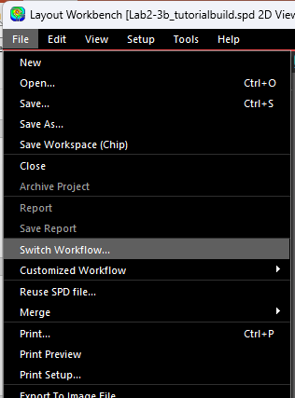
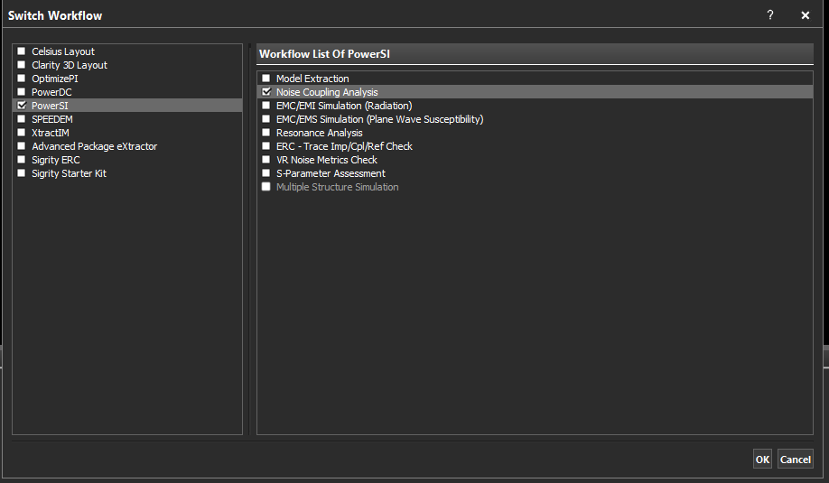
V. Setup for simulating with Spatial Workflow
Click on File
Click on Switch Workflow
Select Noise Coupling analysis
1
3
2

Slide 27
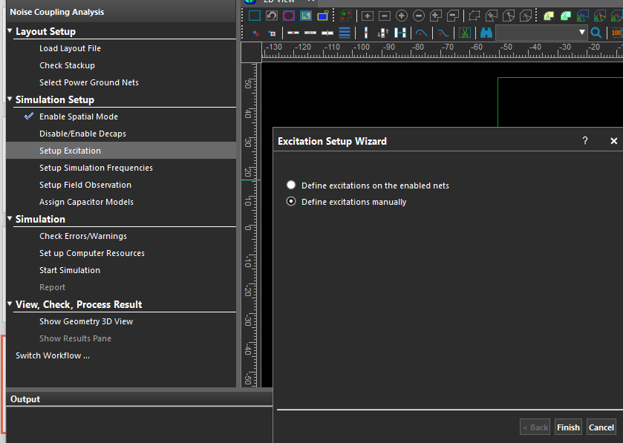
V. Setup for simulating with Spatial Workflow
Add two excitation sources to layout to represent the active components in the design
Steps:
Click Setup Excitation
Click on Define excitations manually then
Click on Finish
1
2
3

Slide 28
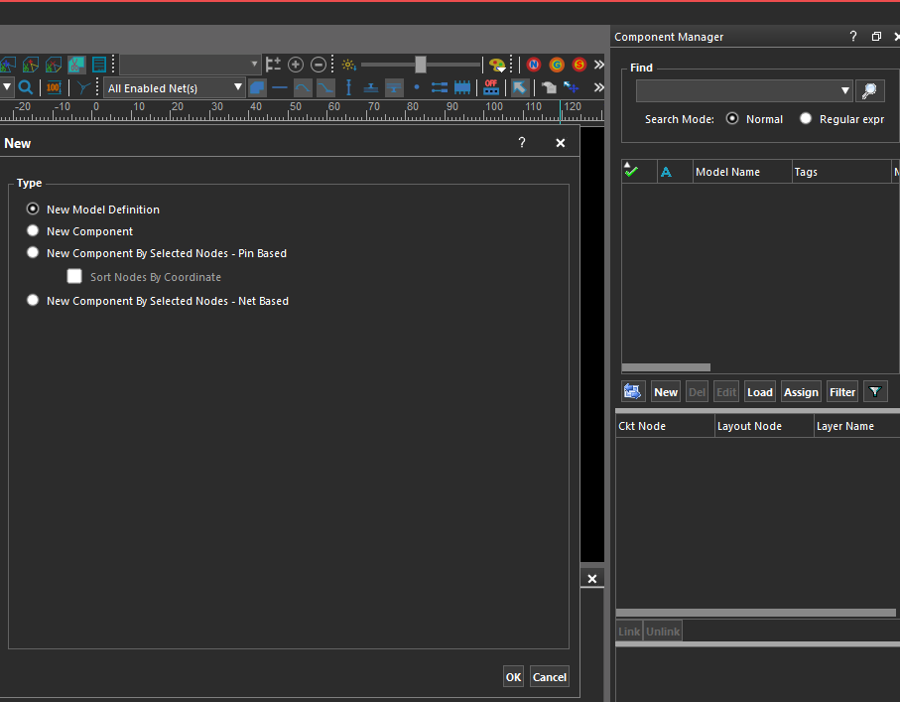
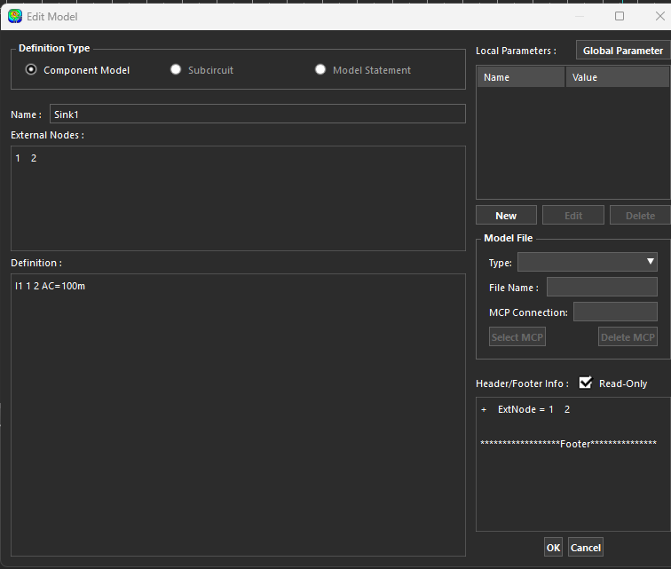
V. Setup for simulating with Spatial Workflow
Define first model Sink1:
Click New button in the Component Manager to select New Model Definition
Select New Model Definition
Click ok
Name New Model Sink1
Provide two external nodes 1 and 2
Define an AC source of 100 mA
4
2
5
6
1
3

Slide 29
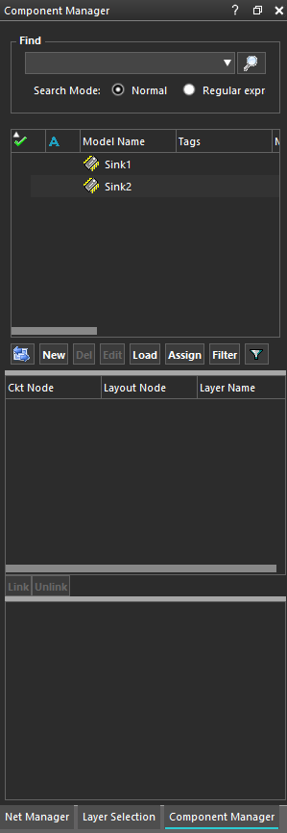
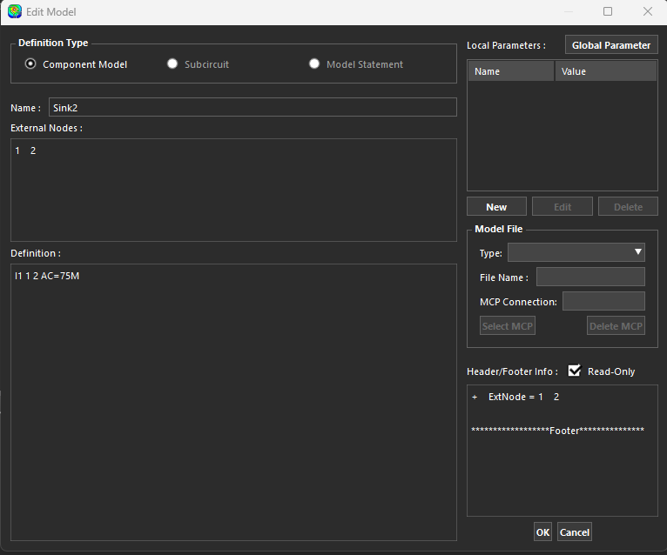
V. Setup for simulating with Spatial Workflow
Define second model Sink2:
Click New button in the Component Manager
Select New Model Definition
Click ok
Name New Model Sink2
Provide two nodes 1 and 2
Define an AC source of 75 mA
Note two models in Component Manager
4
5
2
6
1
3

Slide 30
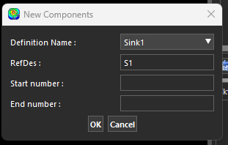
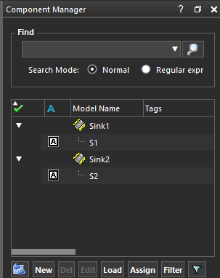
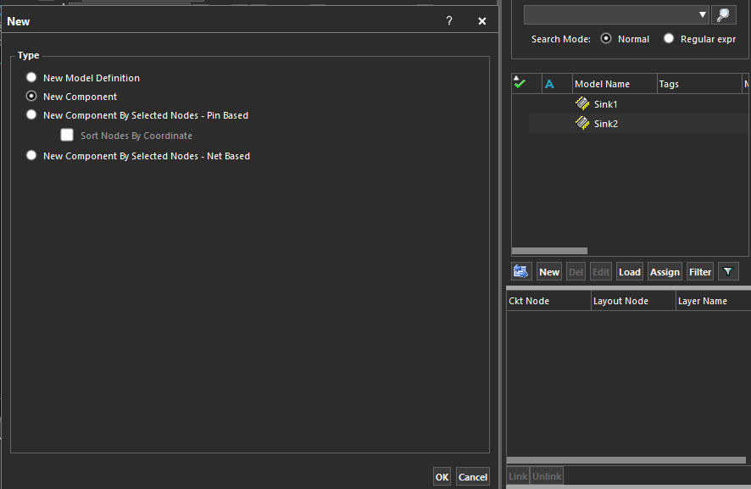
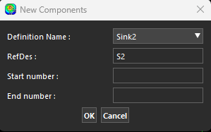
V. Setup for simulating with Spatial Workflow
Create two components that are referenced by models Sink1 and Sink2
Click New button in the Component Manager
Select New Component Definition then
Click OK
Select Sink1 for the model Definition Name
Give component reference designator of S1 and click ok button
Repeat steps 1-3
Select Sink2 for the model Definition Name
Give second component reference designator S2 and slick ok button
Note in the Component Manager that each model references one component
4
5
2
7
8
1
3

Slide 31
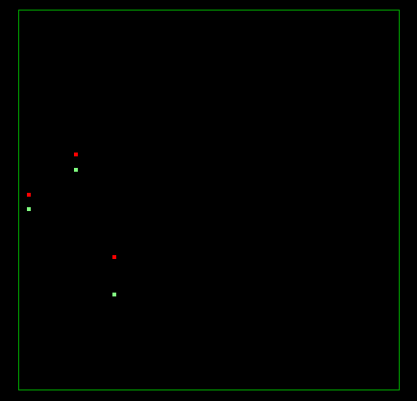
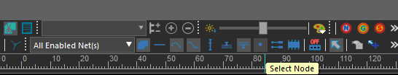
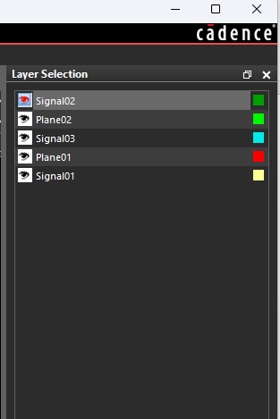
V. Setup for simulating with Spatial Workflow
Connect the two components to the layout VDD and GND nodes at locations shown below
Click on Node icon to activate to make sure we can select nodes in our layout
In Layer Selection Menu, Select Top Layer Signal02 as the Active Layer
1
S1
2
S2

Slide 32
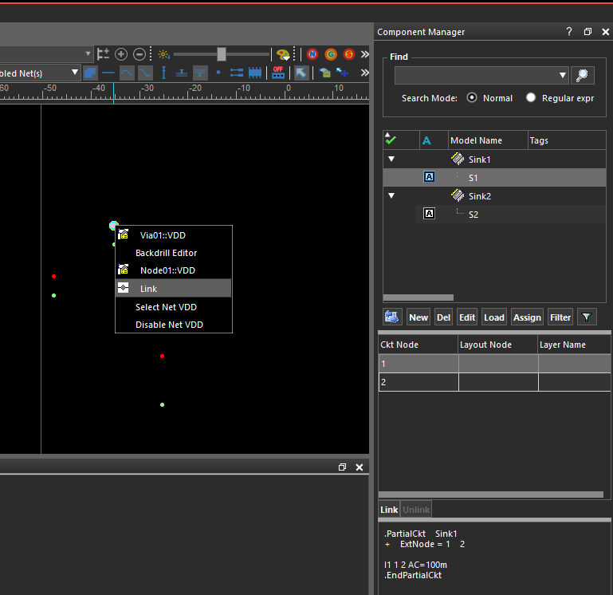
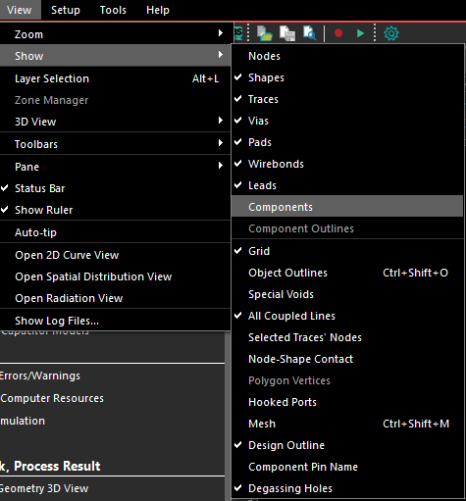
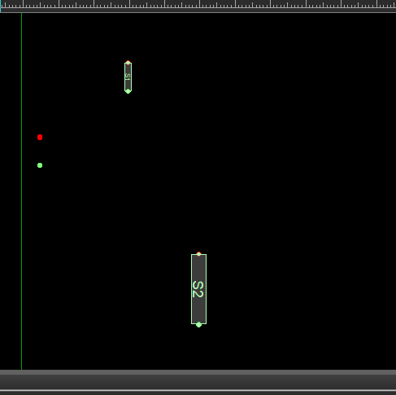
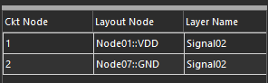
V. Setup for simulating with Spatial Workflow
Connect the two components to the layout VDD and GND nodes at locations shown below
Left click on component S1 in the Component Manager
Left click on the S1 Ckt Node 1
Right click on VDD via node
Left click Link
Left click on S1 Ckt Node 2
Right click on GND via node
Left click link
Repeat steps 2-7 for component S2
Click on View>Show>Components to see components
9
Components visible on layout
1
3
4
2
After linking

Slide 33
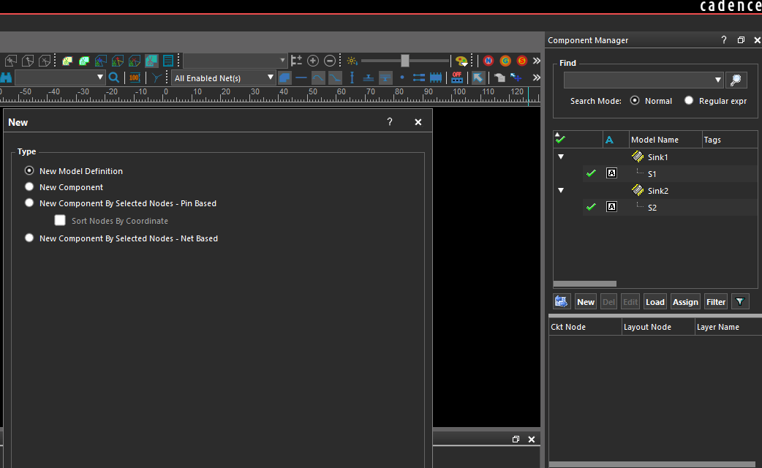
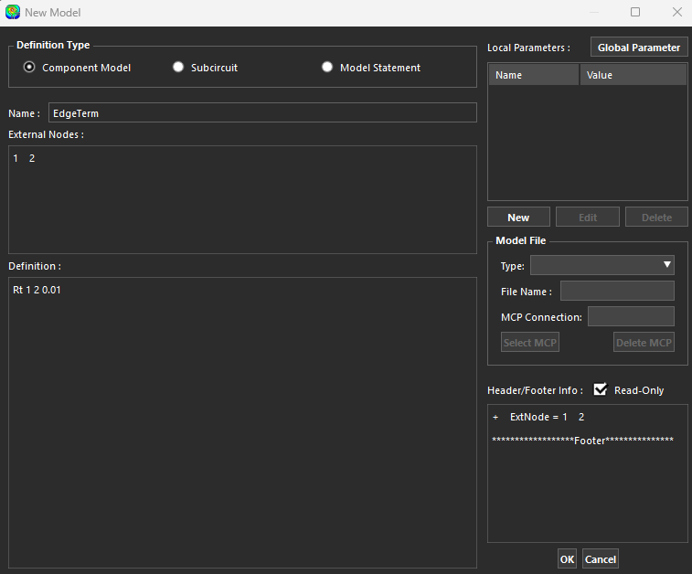
V. Setup for simulating with Spatial Workflow
Creating VRM terminating model as a resistor of .01 ohm
Click new then New Model Definition
Name component model EdgeTerm
Add external nodes (1 2)
Define model as resistor with value 0.01 ohm
2
3
4
1

Slide 34




V. Setup for simulating with Spatial Workflow
Creating a component using Edgeterm model and link to layout
Click New button
Select New Component Type (then click ok)
Select Name EdgeTerm
Give component reference designator of Rt then click ok)
Click Ckt Node 1 of Rt
Right click VDD node
Select link
Similarly click Ckt Node 2 of Rt
Select link
Layout view after linking
2
2
3
6
1
7
4
5
3
4

Slide 35

V. Setup for simulating with Spatial Workflow
Setup Simulation Frequencies
Click on Setup Simulation Frequency to open Frequency Ranges for constant AC course\
Enter start, end and increment frequencies as in screen capture below
1
2

Slide 36


V. Setup for simulating with Spatial Workflow
Specify the plane layers to observe the voltage distributions
Click on Setup Field Observations
Select Add observation between top and bottom planes in the Distribution Observation Wizard
Note Plane02~Plane01 in the Distribution Views
2
1
3

Slide 37



IV. Setup for simulating with Spatial Workflow
Setup observation of voltages at components S1 andS1
Click on Setup>Simulation View>Component Voltage
Click on S1 Component
Left mouse click on Ckt Node 1 for positive node of observation point
Right mouse click Ckt Node 2 for negative node of observation point
Select green for the Curve_Color
Click Add button
Repeat steps 2-6 for S2 component, select Cyan for Curve Color
7
1
5
3
2
4
6

Slide 38


V. Running Spatial mode simulation
Start the simulation
Click on Start Simulation in the workflow panel
Note that voltage distribution simulates across the frequency bandwidth we setup and stops at end frequency (600MHz)
1

Slide 39

V. Running Spatial mode simulation
Find the peak voltage level and frequency at which it occurs
Click Show Peak button to see maximum distribution voltage is about 8.4 V
Slide the frequency slider to find peak frequency at about 200 MHz
2
1

Slide 40

V. Running Spatial mode simulation
Find the peak voltage level and frequency at which it occurs from Spatial Mode Curve
Click the Spatial Mode Curve to see voltage distribution are our two observation points
Note peaks at 200 MHz due to resonant frequency of the power planes
1
2

Slide 41



V. Running Spatial mode simulation
Add decoupling capacitors to reduce the peak voltages at the sink locations and across the layout
First Create new model definition for decoupling capacitors
Click Setup>Component Manager>New button
Select New Model Definition
Name model Capacitor
Provide External Nodes
Define a capacitor with self resonance model of 205

Slide 42



V. Running Spatial mode simulation
Add decoupling capacitors to reduce the peak voltages at the sink locations and across the layout
Create 5 decoupling capacitors form Capacitor model
Click New button in Component Manager
Select New component
Give Reference designator name ‘decap’
Enter 1 for start number and 5 for end
Note 5 decap references are create for Capacitor model
5
2
3
4
1

Slide 43

V. Running Spatial mode simulation
Add decoupling capacitors to reduce the peak voltages at the sink locations and across the layout
Create VDD/GND vias next to sinks and in the voltage ‘hotspots’
Connect decaps at these locations
Rerun simulation to see reduction in peak voltage distribution
Note reduction to 263.1mV

Slide 44




V. Running Spatial mode simulation
Add decoupling capacitors to reduce the peak voltages at the sink locations and across the layout
Change colors of peak voltages (right click color box next to curve name)
Select preferred color
Load Curves from simulation with no decaps by Right click in Loaded Curves area and selecting appropriate file from automatically saved files for each simulation
1
2
3

Slide 45

V. Running Spatial mode simulation
Compare peak voltage distribution with and without decoupling capacitors

Slide 46


VI. Simulating with Extraction Workflow
In the current model using spatial mode simulation:
Change to Workflow to Model Extraction
Save with new model name e.g.<original name>_extractionversion
2
1

Slide 47



VI. Simulating with Extraction Workflow
Use Ports for Extraction Workflow
Go to Setup>Port…
Click New button twice
Change Reference Z(ohm) to 1 ohm (then close Port menu)
Select Port1 in the menu bar pulldown menu
1
3
4
2

Slide 48




VI. Simulating with Extraction Workflow
Right click on VDD via originally connected to S1
Select positive Hook to connect positive port terminal to VDD
Right click on GND via orginally connected to S1
Select negative Hook to connect negative port terminal to GND
Show ports View>Show>Hooked Ports
Similiary repeat steps for S2 location
5
7 View>Show>Hooked Ports
1
7
3
2
4

Slide 49



VI. Simulating with Extraction Workflow
Go to Component Manager and deactive decaps in your model before extraction simulation (click A box twice to see a red X to indicate component is deactivated)
Start Simulation
Select Z parameters from the Extraction menu options
3
1
2

Slide 50





VI. Simulating with Extraction Workflow
Go to Component Manager and reactivate decaps in your model before extraction simulation (click A box once)
Go to Tool bar and click Start Simulation blue arrow
Select Z parameters from the Extraction menu options
Right click in Network Parameters panel and load simulation without decaps for comparison
2
1
No decaps
3
4
Decaps

Slide 51
The End

